Slide 1
South Asian Heritage Month
Sponsors Toolkit 2023

Slide 2
Corporate Pack 2023
01
Welcome
02
Getting Involved
Pack
03
Contents
Speakers
04
Resources
05
Contact

Slide 3
01
Welcome
Are you ready to make a difference in your community and celebrate South Asian heritage?
Join us as a partner, donor, sponsor, or friend of South Asian Heritage Month and be part of our mission to showcase the rich culture and history of South Asia.

Slide 4
01
In just four years
In just four years, we have made a tremendous impact on our community, and with your support, we can make it even bigger and better.
In 2022 we delivered 65 events and listed 140 events over the month!

Slide 5
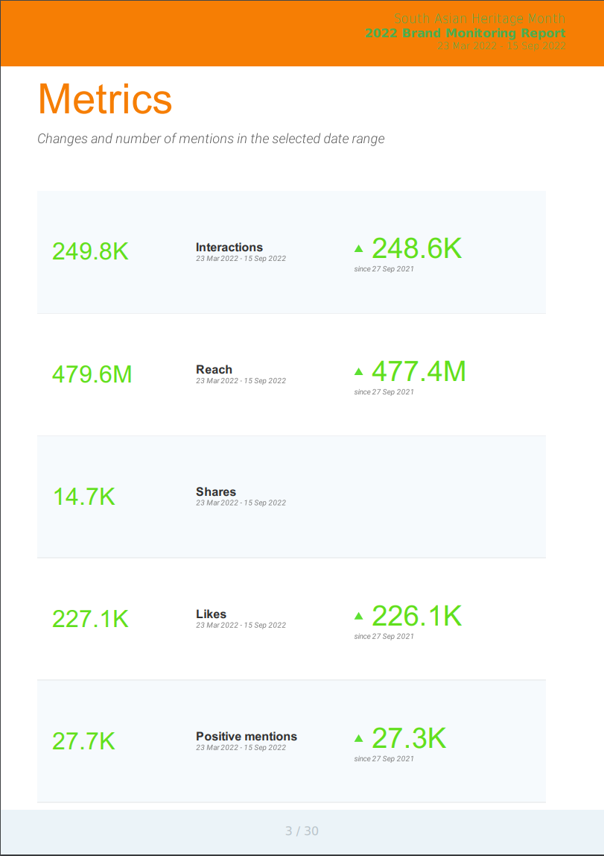
01
Engagement
Our Reach in 2022 !
479.6 MILLION Reach!
454,000 website views!
250,000 interactions
14.7,000 Shares
227,000 Likes across socials

Slide 6
02
Getting Involved
South Asian
Heritage
Month
Whether you are a friend, sponsor, partner or a generous donor, we have an option for you to get involved.
With a diverse range of events planned for this year, there's never been a better time to join us in making South Asian Heritage Month.
PARTNER
FRIEND
DONOR
SPONSOR

Slide 7
02
Our Friends
£5k
By contributing a minimum of £5k, your company can become a friend and prominent supporter of the South Asian Heritage Trust, with your name and logo being prominently featured on our website, demonstrating your invaluable involvement during the South Asian Heritage Month.
FRIEND

Slide 8
02
Our Donors
£10k
For £10k, as a donor, you’ll receive all the benefits and inclusion our friends and supporters receive PLUS additional branding and mentions on our YouTube content and any printed promotions.
DONOR

Slide 9
02
Our Sponsors
£20k
For our corporate sponsors, at £20k, we are offering all the benefits of we offer our friends, supporters and donors. In addition, you also have the opportunity to sponsor a single official SAHM event and get active engagement with our followers across ALL our social media platforms.
SPONSOR

Slide 10
02
Corporate Partners
£30k
For partnership, at £30k we offer sincere partnership for our corporate clients. We offer all the benefits in our sponsorship package and we’ll also stage an exclusive event in partnership with South Asian Heritage Month, providing a dedicated events team, marketing, and Public Relations.
We will also incorporate your company logo as “partnered with” into the event title and slogan when publicising and marketing.
PARTNER

Slide 11
03
Guest Speakers
Guest speakers can add a valuable dimension to any event, and by offering esteemed guest speakers for your South Asian Heritage Month event, you're providing an opportunity to learn from experts in the field of South Asian culture, history, and heritage. These speakers can bring a unique perspective and offer insights that might not be available elsewhere. Additionally, they can help to engage and inspire audiences, leaving a lasting impression on those who attend your events. All fees for Trustees and SAHM Team are direct donations to the Trust. Bios for all are available on our website, https://www.southasianheritage.org.uk/patrons
Patrons - £upon request
Anita Rani
Balvinder Sopal
Nikesh Shukla
Bobby Seagull
Babita Sharma
Bobby Friction Amir Khan
Dr Ranj Singh
Trustees - £1000/h
Jasvir Singh (Co-founder)
Binita Kane (Co-founder)
Natasha Junejo (Trustee, Literary Lead)
Laks Mann (Trustee, LGBTQ+ Lead)
SAHM Team - £500/h
Numan Azmi – North West
Sujata Thaladi – Wales
Prashant Kunwar (Nepal) - International
Umran Ajaib – North East
Premal Bhatt – South West
Mara Hafezi (Sports) – South East

Slide 12
04
Merchandise (coming soon)
Get ready to show off your South Asian pride with our exclusive merchandise! Our range includes flags, pins, tote bags, T shirts, mugs and bandanas - everything you need to mark South Asian Heritage Month in style. Plus, our practical products can be used to decorate your office or add some flair to your daily commute.
And don't worry about breaking the bank - we offer bulk order prices for all our merchandise, making it easy and affordable for businesses and organizations to get involved in the celebration. Whether you're outfitting your entire office or looking for employee gifts, we've got you covered!

Slide 13
04
Downloadable
Whether you're a social media pro or just getting started, we've got everything you need to engage your audience and raise awareness of the celebrations.
Download our South Asian Heritage Month logos and social media assets today, and let's make this year's celebration the best one yet!
Use our official trade mark logos and 2023 social media assets that are guaranteed to help you spread the word and show your support for this important occasion.
If there’s something specific you need, get in touch with our team. Contact details are at the end of this info pack.

Slide 14
04
SOCIAL MEDIA
SCHOOL KIT !
Resources
Image Template sizes for your social media creatives and posts!
For teachers and schools to help learn more about what South Asian Heritage could mean for you!
LOGOS
Get your Logo for Print and for digital here!
#southasianheritagemonth
#ourstoriesmatter
Merchandise
Events !
(coming soon!!!)
Flags, Pins, Bunting, Mugs
T Shirts, Bandanas and more!
So you have an event you want to share, upload it now to our site and let us know about it!
Tag us so we can pick up your posts and share!

Slide 15
05
Contact US
Website:
www.southasianheritage.org.uk
General:
Info@southasianheritage.org.uk
Trustees:
Jasvir@southasianheritage.org.uk
Binita@southasianheritage.org.uk
Natasha@southasianheritage.org.uk
Laks@southasianheritage.org.uk
Events:
Events@southasianheritage.org.uk
@SAHM_UK
/southasianheritagemonth
/southasianheritagemonth_uk
/south-asian-heritage-month
/southasianheritagemonth

