Slide 1
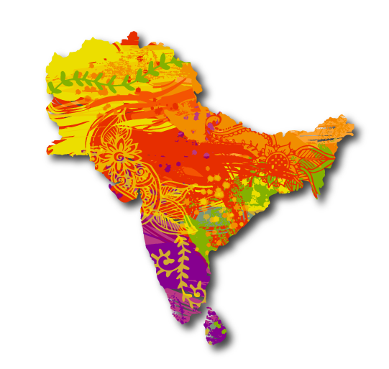
South Asian Heritage Month
2023 !
EVENT TOOLKIT

Slide 2
The Theme for 2023 is… STORIES TO TELL

Slide 3
Event Toolkit 2023
01
Why Stories to Tell?
02
Event Ideas
Your KIT
03
Your Check List
Contents
04
Resources
05
Contact Us

Slide 4
01
Why Stories to Tell?
Get ready to be transported to a world of vibrant colours, intricate designs, and rich history!
Once upon a time, two friends sat in a cosy cafe, sipping on chai and chatting away about their love for all things South Asian. As they chatted, they realized that many people in the UK had little understanding of the connections between the UK and South Asia.
They put their heads together, and voila! South Asian Heritage Month was born!

Slide 5
01
Connecting together
This is no ordinary celebration, my friends.
It's a time when people from all walks of life come together to appreciate the beautiful stories and traditions of those with South Asian heritage.
And this year's theme is all about the power of storytelling!
We believe that stories have the ability to connect us, inspire us, and deepen our understanding of the world.

Slide 6
01
Whatever option you like
So let's grab some flavourful food, put on some of your favourite South Asian vibes, and celebrate South Asian Heritage Month by sharing our own stories and listening to the stories of others.
Whether it's through art, literature, music, or simply chatting over some delicious chai, let's come together and discover the richness and diversity of our experiences.

Slide 7
01
Tell us about your event
And hey, if you're planning an event for South Asian Heritage Month, we've got your back!
This toolkit is chock-full of helpful resources and ideas to make your celebration a success.
Let's come together and share our stories - who knows, you might just discover a new favourite tradition!

Slide 8
02
Film Screening
Comedy Night
Panel Discussion
Fashion Show
Cooking Class
Open Mic Night
IDEAS
Quiz Night
Art Exhibition
Workshops
Poetry Night
Coffee Gup Shup
Family Fun Day

Slide 9
03
Your Check List
South Asian Heritage Month (SAHM) is a great opportunity to celebrate and showcase the rich cultural heritage of South Asia.
Whether you're planning an offline or online event, here are some steps you can take to create and submit your event in a fun and engaging way…

Slide 10
03
Your Check List
1. Choose a theme: Decide on a theme that aligns with the SAHM's mission and resonates with your target audience. This will help you create a focused and engaging event.
2. Plan your event: Plan your event in detail, including the date, time, location (if applicable), format (online/offline), and the activities you'll be organizing. Make sure you take into account the needs and preferences of your target audience.
3. Engage with the community: Reach out to your local South Asian community in your area and get them involved in your event. You can do this by partnering with local organizations, inviting guest speakers, and promoting your event through social media and other platforms.

Slide 11
03
Your Check List
4. Create buzz: Create buzz around your event by using creative marketing strategies, such as social media campaigns, influencer partnerships, and targeted advertising. Make sure your messaging is clear, concise, and engaging.
5. Submit your event: Once you've finalized your event, submit it to the SAHM website for listing. Make sure you provide all the necessary details, such as event name, description, date, time, location, registration details and a square image of the event tile.
6. Follow up: Follow up with the SAHM team to ensure that your event has been approved and is listed on their website. You can also ask for their feedback and suggestions on how to make your event even more engaging and impactful.

Slide 12
03
Your Check List
7. Execute your event: Finally, execute your event with enthusiasm and energy.
Make sure you create a welcoming and inclusive environment for all attendees, and encourage them to participate and share their experiences on social media.
Use the hashtags:
#southasianheritagemonth
#ourstoriesmatter

Slide 13
04
Resources
Remember, the key to creating a fun and engaging SAHM event is to be creative, inclusive, and culturally sensitive.
By following these steps, you can create an event that celebrates the diversity and richness of South Asian culture and inspires others to do the same.
You’re not on your own! We’ve put together some resources so you can brand and make the whole experience SUPER South Asian Heritage Month!

Slide 14
Just click the icons
SOCIAL MEDIA
SCHOOL KIT !
Clicking on the icons will take you to the download areas on our awesome shared drive full of resources.
Image Template sizes for your social media creatives and posts!
For teachers and schools to help learn more about what South Asian Heritage could mean for you!
LOGOS
Get your Logo for Print and for digital here!
#southasianheritagemonth
#ourstoriesmatter
Merchandise
Events !
(coming soon!!!)
Flags, Pins, Bunting, Mugs
T Shirts, Bandanas and more!
So you have an event you want to share, upload it now to our site and let us know about it!
Tag us so we can pick up your posts and share!

Slide 15
05
Contact US
Website:
www.southasianheritage.org.uk
General:
Info@southasianheritage.org.uk
Trustees:
Jasvir@southasianheritage.org.uk
Binita@southasianheritage.org.uk
Natasha@southasianheritage.org.uk
Laks@southasianheritage.org.uk
Events:
Events@southasianheritage.org.uk
@SAHM_UK
/southasianheritagemonth
/southasianheritagemonth_uk
/south-asian-heritage-month
/southasianheritagemonth

